Slide 1
ENERGY SOURCES
AND
POLLUTION

Slide 2
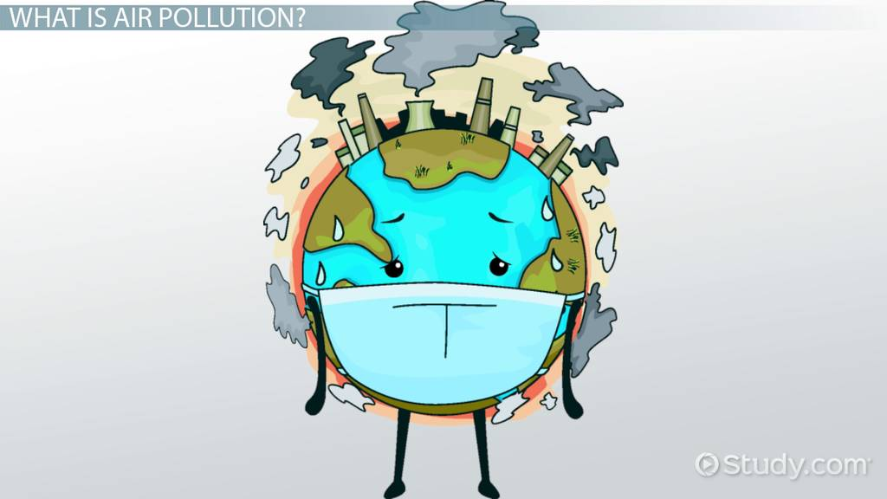

Slide 3
Which Types of Energy Source Produces the Most Pollution?
Energy generation is the number one cause of air pollution and the leading cause of global warming emissions in the United States. Energy is often classified as “dirty” or “clean,” but that isn’t the whole story. Advanced energy solutions can blur the line and make this distinction irrelevant as advances in all forms of energy lead to cleaner solutions.
Here are the most common types of energy sources ranked in terms of pollution and carbon emissions

Slide 4
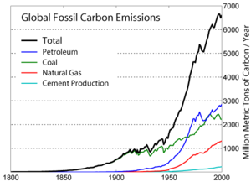
Coal
Coal produces more pollution than any other energy source. While coal produces just 44% of U.S. electricity, it accounts for 80% of power plant carbon emissions. Burning coal leads to soot, smog, acid rain, global warming, and carbon emissions. It also generates a great deal of waste, including sludge, toxic chemicals, and heat. Coal pollutes during every stage of the energy production process, from mining and transportation to storage and burning.
Coal is one of three types of fossil fuel energy — along with natural gas and oil — but it won’t last forever. Reserves of fossil fuels are limited and it’s believed they will be exhausted after 100 years. Fortunately, coal is on the decline. Many aging coal plants are being shut down and virtually no new coal plants are being constructed.

Slide 5
Natural Gas
Like coal, natural gas is a fossil fuel that contributes to air pollution and has environmental and health risks. The global warming emissions from natural gas are lower than with coal and oil, but emissions are only part of the story with natural gas.
Drilling and extracting natural gas and transporting it in pipelines results in the leakage of methane, the main component of natural gas that’s 35 times stronger than carbon dioxide at trapping heat. Land disturbance for gas and oil drilling also harms ecosystems through erosion and pollutants that leak into nearby streams. There are also well-documented cases of groundwater near gas wells becoming contaminated with gases and fracking fluids.
Unfortunately, lawmakers in states that depend heavily on fossil fuels often downplay these concerns. When residents in some fracking communities showed that the water coming from their faucets could actually be lit on fire, Colorado Republican senator Randy Baumgardner claimed it was merely propaganda and a natural phenomenon. No need to worry; water is supposed to catch fire.

Slide 6
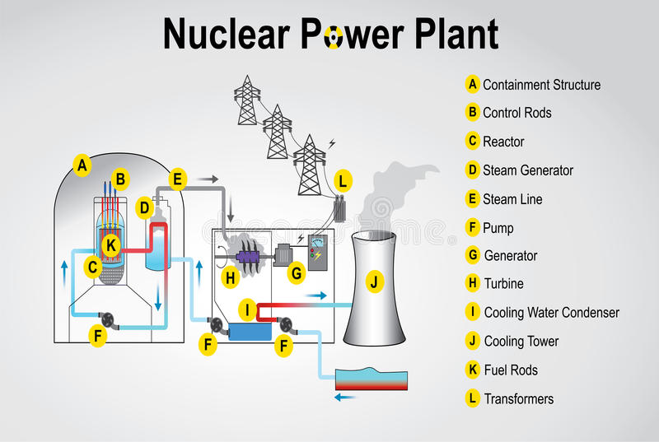
Nuclear
Nuclear energy is one of the biggest sources of renewable energy in the world, although it’s not entirely clean. Nuclear energy is emission-free and saves about 2.4 billion tons of carbon emissions per year that would otherwise result from coal, but it results in radioactive, high-level waste (HLW). Unlike other types of industrial waste, the level of hazard of nuclear waste does decrease over time. Waste that results from nuclear energy production needs to be dealt with safely.

Slide 7
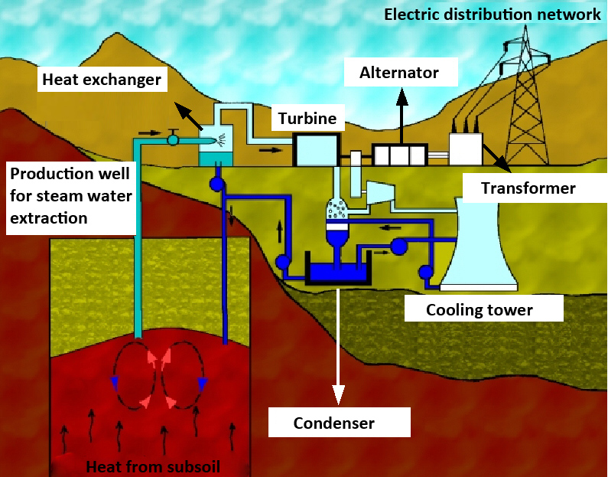
Geothermal
Geothermal is a clean energy source that uses energy produced from beneath the earth. Beneath the earth’s crust, high temperatures are the result of a slow decay of radioactive particles. Hot rocks beneath the surface heat up water to produce steam which is then captured and moves turbines. Rotating turbines generate power for generators.
While this energy source is clean, it can only be produced in certain areas of the world.

Slide 8
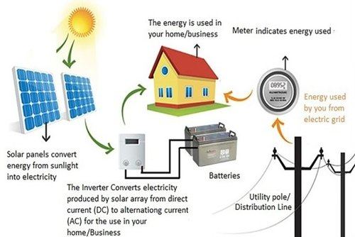
Solar
Solar panels allow for the collection of solar energy from the sun that can be turned into power. Many homes are now equipped with solar panels to run at least some amount of the home’s electricity and some corporations are even jumping on board
While solar is a clean source of energy that does not produce air pollution, it’s only available in certain geographical areas that get direct sun long enough to generate usable power.

Slide 9
Wind is a clean source of energy
Wind is a clean, free, and readily available renewable energy source. In 2019 wind energy saved 118 million tonnes of CO₂ in Europe and could save up to 270 million tonnes in 2030 – the equivalent of Spain’s annual CO₂ emissions.
Wind does not need to be mined or shipped and the more we use, the closer Europe gets to real energy independence.
Operating wind turbines do not emit greenhouse gases like carbon dioxide ( CO₂) or any other air pollutant such as nitrogen oxide (NOx), sulphur oxide (SOx), or particulate matter (PM).
Wind energy is sustainable
Wind energy’s water footprint is almost zero, unlike most other forms of electricity generation.
Although there are CO₂ emissions associated with the construction, transport, operation and dismantling of wind turbines these emissions are paid back in less than one year of operation.
Wind turbines are made of standard materials such as concrete, steel, and composite materials for blades. The cement used for turbine foundations is an inert material that does not pollute the soil.
The wind industry and its supply chain are working to develop resource-efficient and sustainable materials, such as low-carbon steel and recyclable composites for blades.
Different turbine models use different quantities of rare earths, mainly in permanent magnets. WindEurope is part of the European Raw Materials Alliance which is working to develop a permanent magnet supply chain for Europe. The industry is working to improve material efficiency, recycling, and substitution.
Wind farms allow for a sustainable use of land and sea
Wind turbines can be built on farms and coexist with many forms of agricultural and other activities.
Wind farms can have positive effects on biodiversity by helping to preserve habitats and ecosystems. Once wind farms have been built their sites are left undisturbed for many years. Many onshore wind farms contain areas of pollinator-friendly habitat.
At offshore wind farms bottom trawling and dredging cannot take place, which helps us preserve the seabed.
The wind industry works with local partners to maximise this positive impact. This has led, for example, to artificial reef substructures being added in between offshore wind turbines to further enhance biodiversity.

